Slide 1
Web Application Testing GYNIA – Private Hospital
Final Project

Slide 2


About
Gynia
Web application
Private hospital – maternity and women related medical procedures

Slide 3

TESTING APPROACH
Ad-hoc Testing to decide if the application is worth further testing
Exploratory Testing for the entire application
Document the Exploratory Testing and write down the defects so they can be replicated
Positive and negative testing for Create Account functionality, as well as executing the test cases
Write the Smoke tests and execute them
Write the Test Report

Slide 4

TOOLS USED
Mantis Bug Tracker – Bug Reporting
TestLink – Test Case Management
Snipping Tool – Screenshots Capture
Xmind Tool – Mind Maps

Slide 5

TESTING TYPES
PERFORMED
APPLICABLE
Functional Testing
ExploratoryTesting
Negative Testing
Positive Testing
Smoke Testing
Compatibility Testing
UI Testing
Usability Testing
Performance Testing
Security Testing

Slide 6
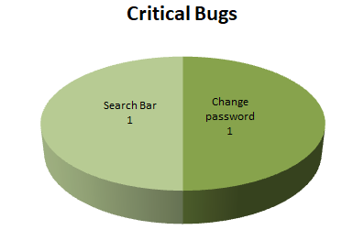
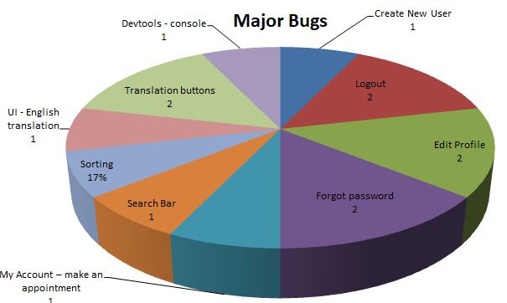
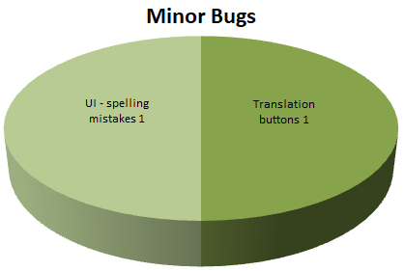
BUGS OVERVIEW
Total: 18 Bugs

Slide 7
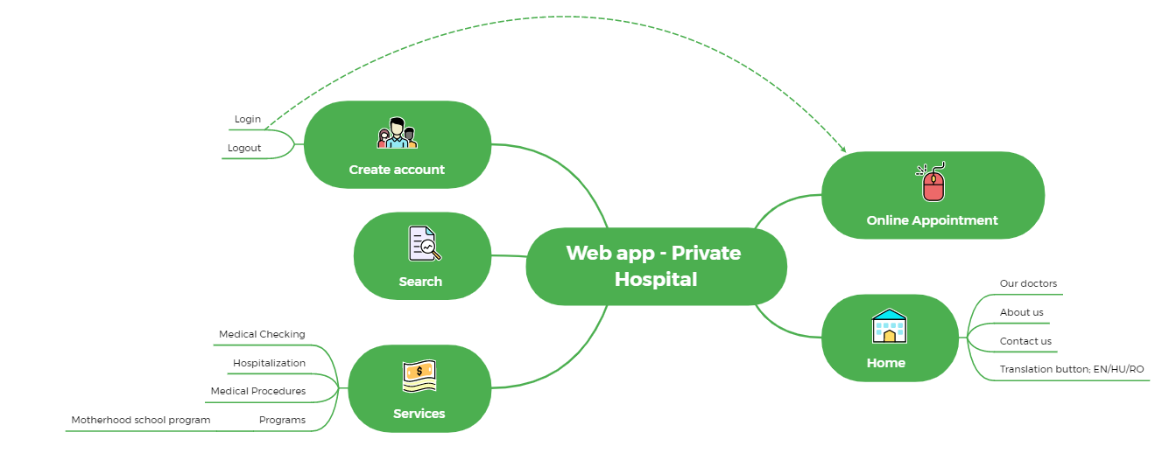
Main Functionalities Mind Map

Slide 8
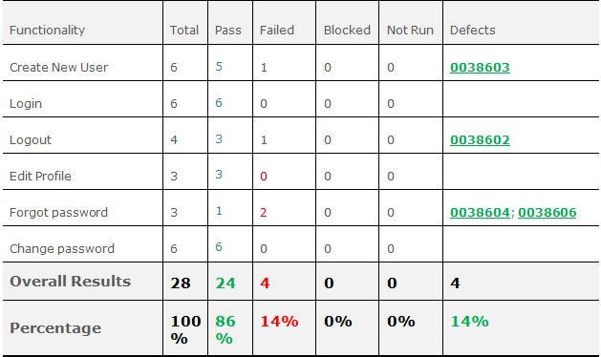
TEST CASES RESULTS (Without Smoke Testing Suite)

Slide 9

CONCLUSIONS
10 Test Cases were executed to test the happy flows: 9 passed and 1 failed
18 bugs identified: 2 critical, 14 major and 2 minor
Most of the bugs were identified by performing Exploratory Testing and Negative Testing
Data type used during testing: Blank, Valid and Invalid
Fixing at least the major and critical
severity bugs is recommended

Slide 10
LESSONS LEARNED
Challenges
Lessons
Finding a buggy app was the main challenge
Lack of requirements
Using too much invalid data in production
Keep the bug reporting and test cases steps and results easy
to follow
Exploratory Testing facilitates learning of functionalities
Less is more,
simple steps are
better to use for
writting test cases
or reporting bugs

Slide 11
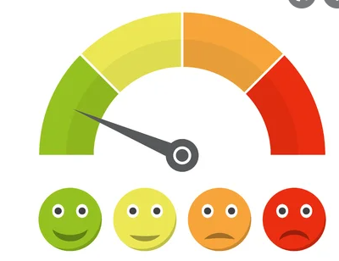
THANK YOU

